Slide 1
Chapter 3 Algorithms
Section 3.1 : Algorithms

Slide 2
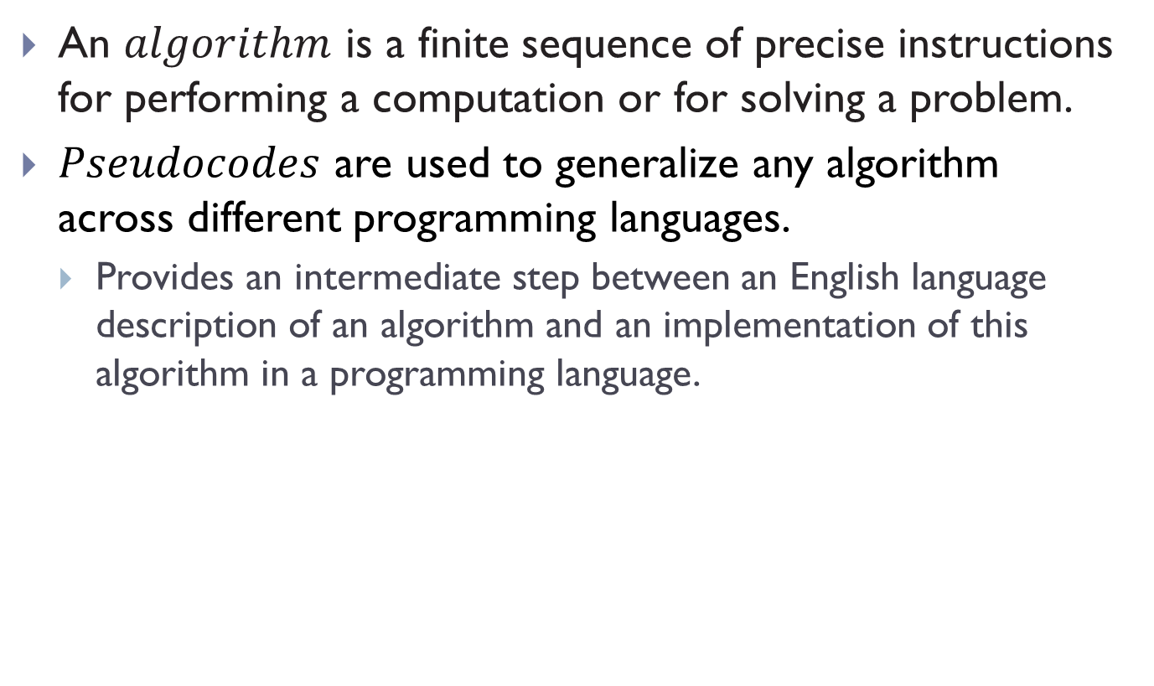
Algorithms
An $algorithm$ is a finite sequence of precise instructions for performing a computation or for solving a problem.
$Pseudocodes$ are used to generalize any algorithm across different programming languages.
Provides an intermediate step between an English language description of an algorithm and an implementation of this algorithm in a programming language.

Slide 3
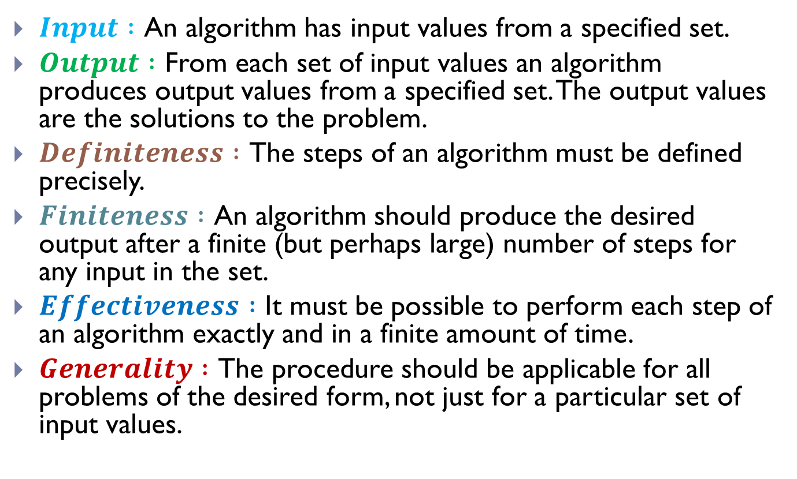
Properties of Algorithms
$Input :$ An algorithm has input values from a specified set.
$Output :$ From each set of input values an algorithm produces output values from a specified set. The output values are the solutions to the problem.
$Definiteness :$ The steps of an algorithm must be defined precisely.
$Finiteness :$ An algorithm should produce the desired output after a finite (but perhaps large) number of steps for any input in the set.
$Effectiveness :$ It must be possible to perform each step of an algorithm exactly and in a finite amount of time.
$Generality :$ The procedure should be applicable for all problems of the desired form, not just for a particular set of input values.

Slide 4
Searching Algorithms
The task of locating an element in an ordered list in different contexts are called searching problems.
For instance, a program that checks the spelling of words searches for them in a dictionary, which is just an ordered list of words.
Searching Algorithms:
Linear Search
Binary Search

Slide 5
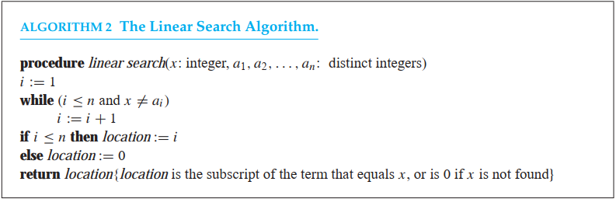
Searching Algorithms (Contd.)
Linear Search:
INPUT: An ordered list of elements.
OUTPUT: Index of the desired element in the list (if found).

Slide 6
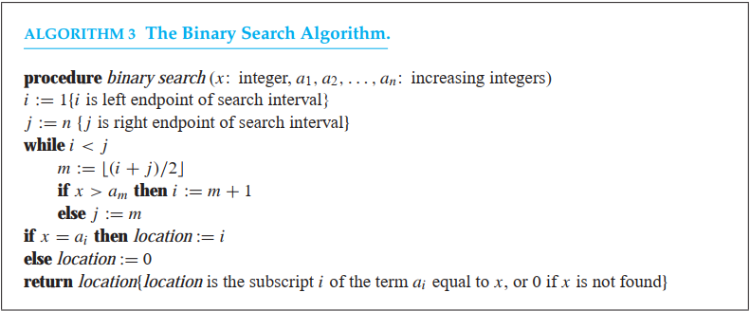
Searching Algorithms (Contd.)
Binary Search:
INPUT: A list of elements sorted in Ascending order.
OUTPUT: Index of the desired element in the list (if found).

Slide 7
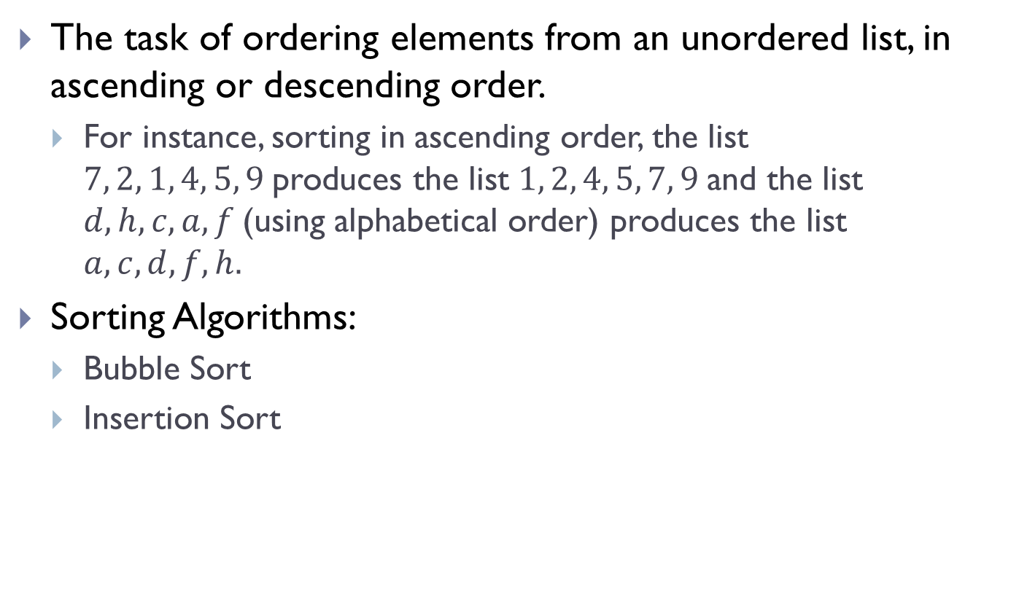
Sorting Algorithms (Contd.)
The task of ordering elements from an unordered list, in ascending or descending order.
For instance, sorting in ascending order, the list $7, 2, 1, 4, 5, 9$produces the list $1, 2, 4, 5, 7, 9$and the list $d, h, c, a, f$(using alphabetical order) produces the list $a, c, d, f, h.$
Sorting Algorithms:
Bubble Sort
Insertion Sort

Slide 8
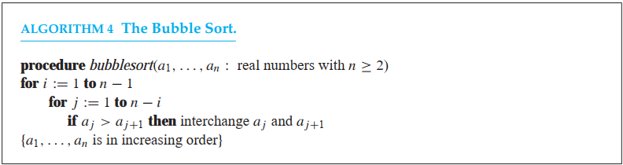
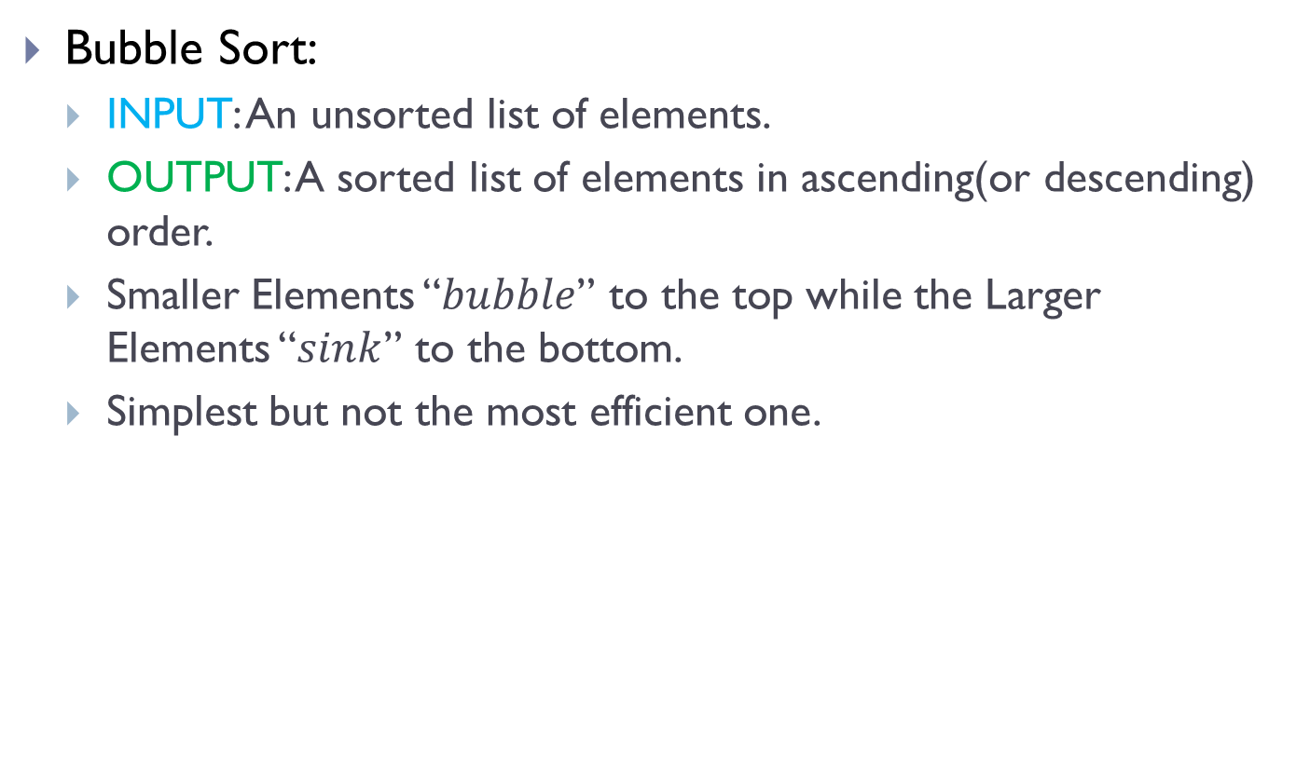
Sorting Algorithms (Contd.)
Bubble Sort:
INPUT: An unsorted list of elements.
OUTPUT: A sorted list of elements in ascending(or descending) order.
Smaller Elements “$bubble$” to the top while the Larger Elements “$sink$” to the bottom.
Simplest but not the most efficient one.

Slide 9
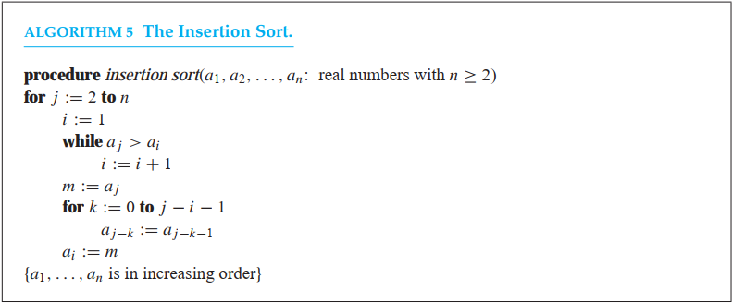
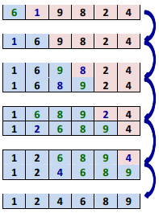
Sorting Algorithms (Contd.)
Insertion Sort:
INPUT: An unsorted list of elements.
OUTPUT: A sorted list of elements in ascending(or descending) order.
Simple but usually not the most efficient one.

Slide 10

Greedy Algorithms
Selects the best option instead of considering all possible options that may lead to an optimal solution.
Once known, that a $Greedy Algorithm$ finds a feasible solution, it is necessary to determine optimality of the solution.

Slide 11
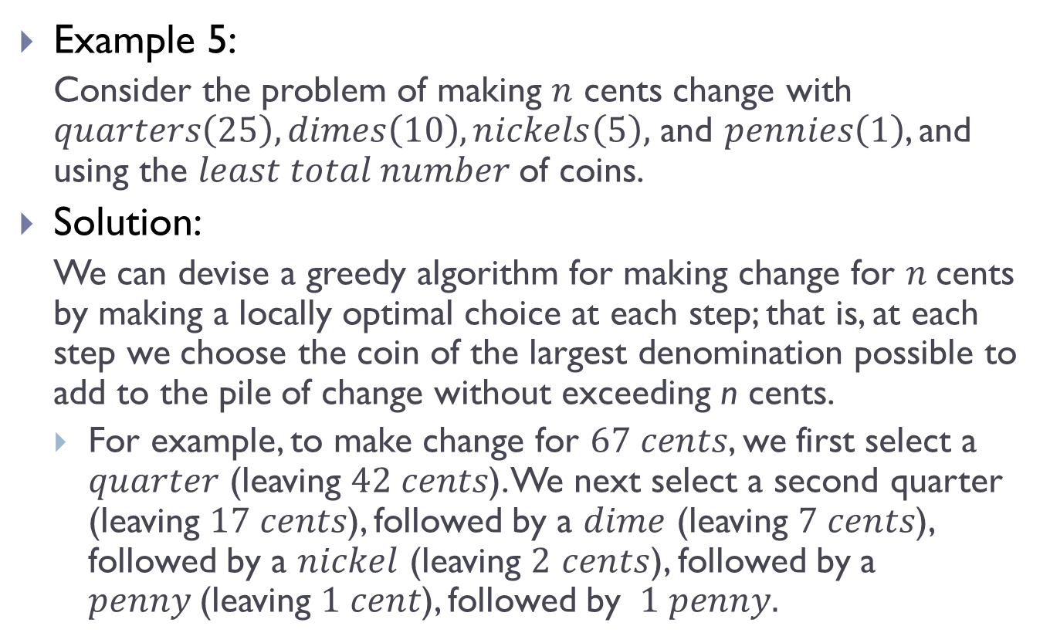
Greedy Algorithms(Contd.)
Example 5:
Consider the problem of making $n$ cents change with $quarters\left(25\right), dimes\left(10\right), nickels\left(5\right),$ and $pennies\left(1\right)$, and using the $least total number$of coins.
Solution:
We can devise a greedy algorithm for making change for $n$cents by making a locally optimal choice at each step; that is, at each step we choose the coin of the largest denomination possible to add to the pile of change without exceeding n cents.
For example, to make change for $67 cents$, we first select a $quarter$ (leaving $42 cents$). We next select a second quarter (leaving $17 cents$), followed by a $dime$ (leaving $7 cents$), followed by a $nickel$ (leaving $2$ $cents$), followed by a $penny$(leaving $1 cent$), followed by $1 penny.$

Slide 12
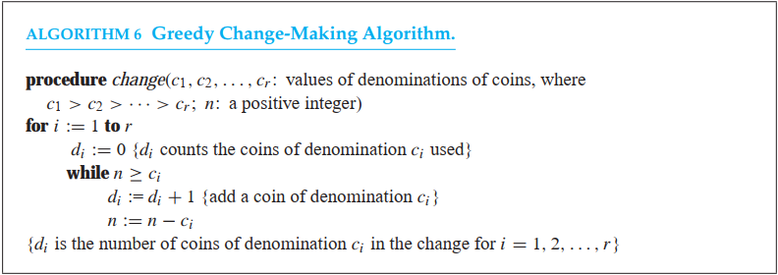
Greedy Algorithms(Contd.)

Slide 13

The Halting Problem
Problem Statement:
$Is there any procedure that takes as input$
$A computer program and$
$Input to the program$
$and determines whether the program will eventually$ $stop when run with this input?$

Slide 14
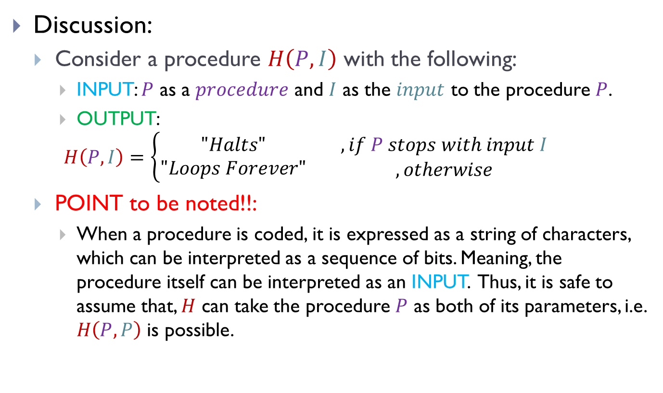
The Halting Problem(Contd.)
Discussion:
Consider a procedure $H\left(P, I\right)$ with the following:
INPUT: $P$ as a $procedure$ and $I$ as the $input$ to the procedure $P$.
OUTPUT:
$$H\left(P, I\right)=\left\{\begin{matrix}"Halts" \\ "Loops Forever"\end{matrix} \begin{matrix}, if P stops with input I \\ , otherwise\end{matrix}\right.$$
POINT to be noted!!:
When a procedure is coded, it is expressed as a string of characters, which can be interpreted as a sequence of bits. Meaning, the procedure itself can be interpreted as an INPUT. Thus, it is safe to assume that, $H$ can take the procedure $P$ as both of its parameters, i.e. $H\left(P, P\right)$ is possible.

Slide 15
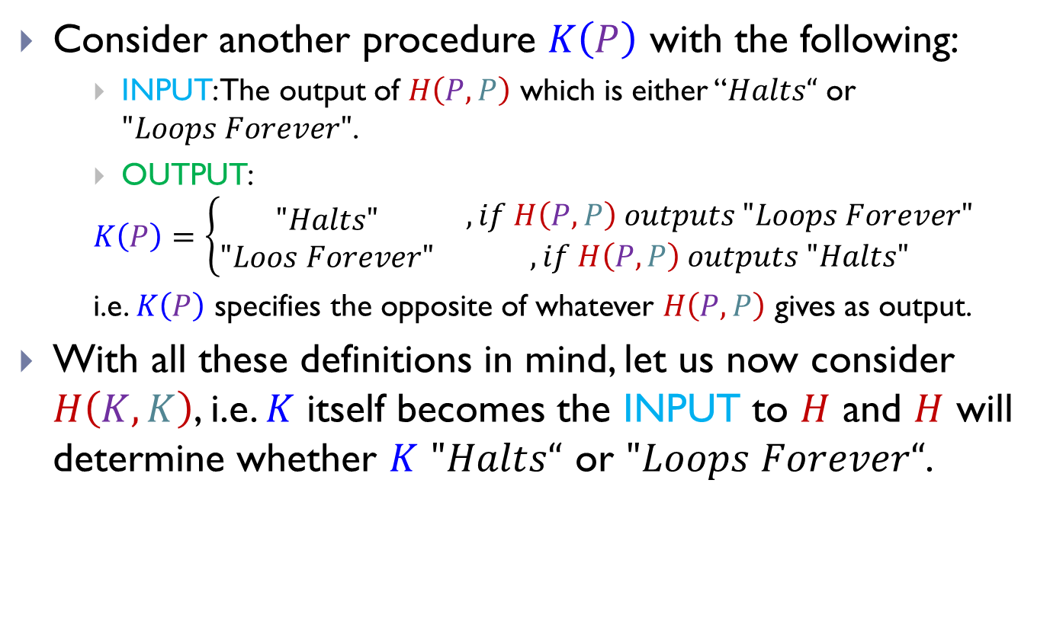
The Halting Problem(Contd.)
Consider another procedure $K\left(P\right)$ with the following:
INPUT: The output of $H\left(P, P\right)$ which is either “$Halts“$ or $"Loops Forever"$.
OUTPUT:
$$K\left(P\right)=\left\{\begin{matrix}"Halts" \\ "Loos Forever"\end{matrix}\right. \begin{matrix}, if H\left(P, P\right) outputs "Loops Forever" \\ , if H\left(P,P\right) outputs "Halts"\end{matrix}$$
i.e. $K\left(P\right)$ specifies the opposite of whatever $H\left(P, P\right)$ gives as output.
With all these definitions in mind, let us now consider $H\left(K, K\right)$, i.e. $K$ itself becomes the INPUT to $H$ and $H$ will determine whether $K$ $"Halts“$ or $"Loops Forever“$.

Slide 16

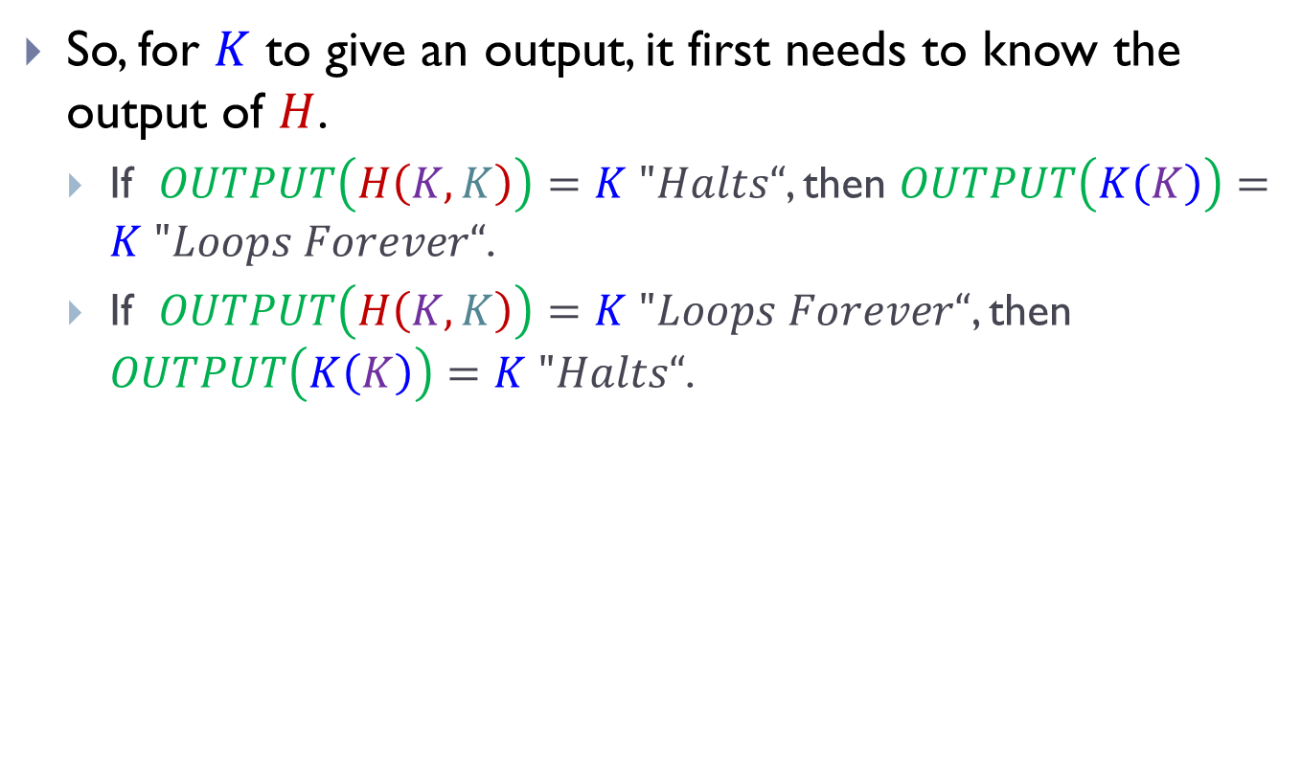
The Halting Problem(Contd.)
So, for $K$ to give an output, it first needs to know the output of $H$.
If $OUTPUT\left(H\left(K, K\right)\right)=K "Halts“$, then $OUTPUT\left(K\left(K\right)\right)=K "Loops Forever“$.
If $OUTPUT\left(H\left(K, K\right)\right)=K "Loops Forever“$, then $OUTPUT\left(K\left(K\right)\right)=K "Halts“$.

Slide 17
The Halting Problem(Contd.)
We knew that was easy!!!!!

Slide 18
The Halting Problem(Contd.)
Wait…….WHAT!!!!!?????

Slide 19
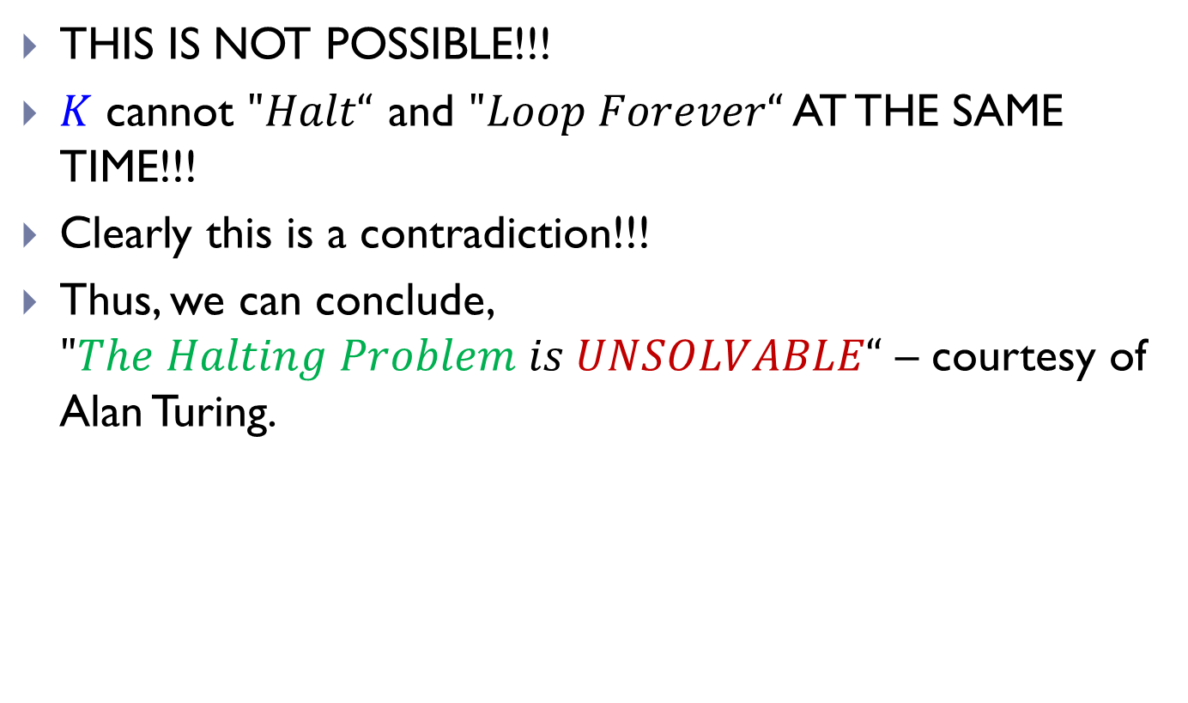
The Halting Problem(Contd.)
THIS IS NOT POSSIBLE!!!
$K$ cannot $"Halt“$ and $"Loop Forever“$ AT THE SAME TIME!!!
Clearly this is a contradiction!!!
Thus, we can conclude, $"The Halting Problem is UNSOLVABLE“$ – courtesy of Alan Turing.

Slide 20
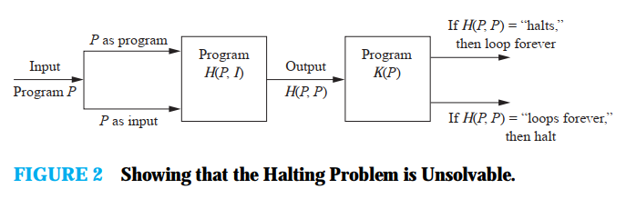
The Halting Problem(Contd.)

Slide 21
THE END

